Slide 1

“News Portal”
PROJECT MEMBERS
Vivek S. Mishra (135223693057)
Dharmendra D. Meniya (135223693056)
Shailesh K. Limbadiya(135223693078)
Kuntal H. Vagadiya(135223693090)
ROJECT GUIDE
Mr. Pritesh Madlani
MARWADI EDUCATION FOUNDATION’S
GROUP OF INSTITUTIONS
RAJKOT, GUJARAT.
2014 – 2015

Slide 2
Contents
Sr.No. | Particulars
1 | Project Profile
2 | Technical Description
3 | Project Modules
4 | Data Flow Diagram
5 | E-R Diagram
6 | Data Dictionary
7 | Snapshot
8 | Future Enhancement
9 | Bibliography

Slide 3
PROJECT PROFILE
“News Portal” Publishing portal provides an easy way to professionally publish an online news publication, corporate press releases, or manage other content without technical expertise. It is most often used as an online newspaper.
Our News Publishing system provides flexible, easy-to-use content management focused on minimizing. It combines content creation, graphics, and publication controls.
Design a website with wide range of custom modules like top stories section, breaking news section, advance search option, photo gallery, video uploading services etc.

Slide 4
FEATURES:
Top Stories Section
Features the hottest news articles in this module.
Breaking News
This column on the website features the breaking news section revealing the top most news to the site visitors.
Advertisement
Advertisement module can be controlled from admin section and display flash and static images, adding onto the revenue of the client.
Photo Gallery
Photo gallery can be managed by admin section and can be categorize into different sections like on sport section photo gallery related to sport will be displayed and so on.

Slide 5
TECHNICAL DESCRIPTION
Project Name : | Online Appointment
Front-End-Tool : | PHP
Back-End-Tool : | MySQL
Documentation : | MS-Word 2013
Duration : | 3 Months

Slide 6
PROJECT MODULES
Admin Side:
Add New News
Check all News
Update or Delete all News
Check Feedback
Client Side:
Search News
Show Categories wise news
Show Detailed news
Show photo gallery
Feedback

Slide 7
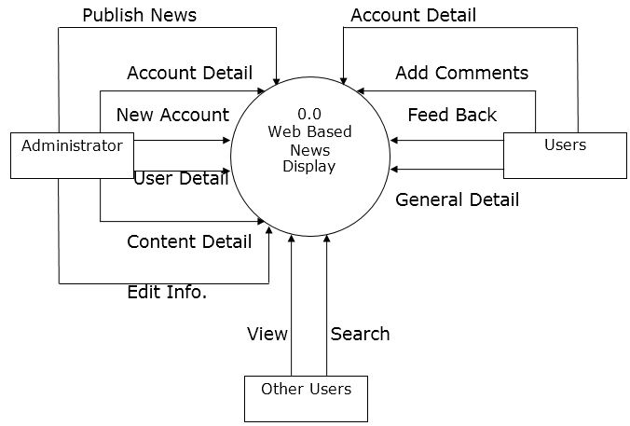
Data flow diagram
Context Level Diagram.

Slide 8
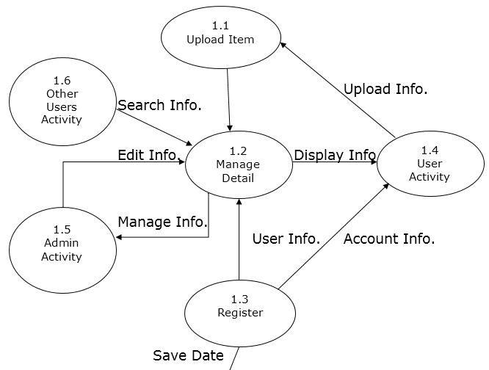
Data flow diagram
Level 1 Diagram.
Database

Slide 9
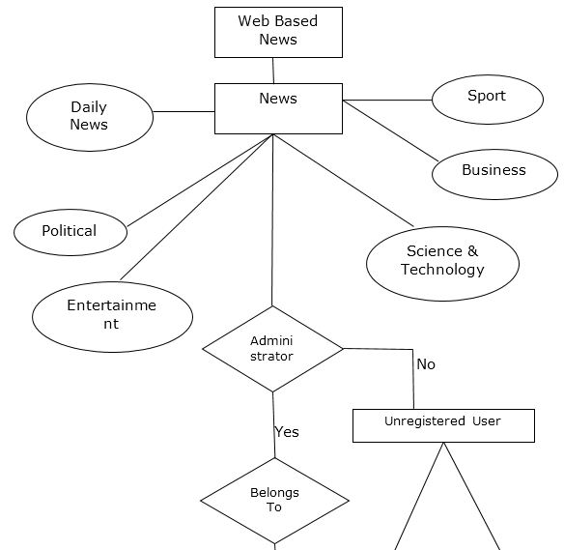
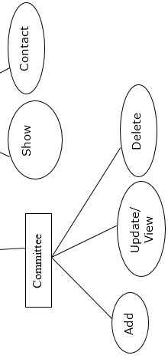
E-r diagram

Slide 10
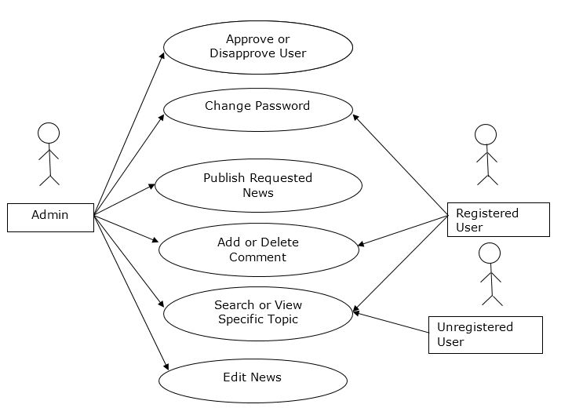
Use Case Diagram

Slide 11
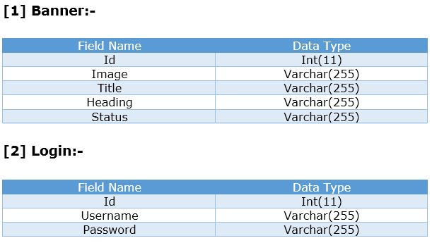
Data dictionary

Slide 12
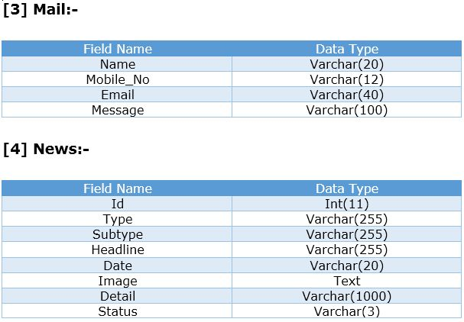
Data dictionary

Slide 13
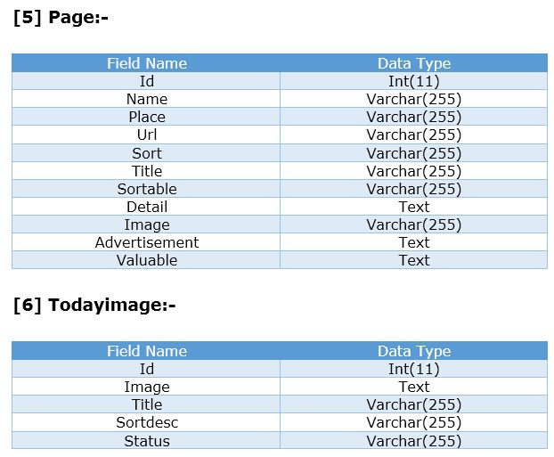
Data dictionary

Slide 14
snapshots
clIENT SIDE

Slide 15
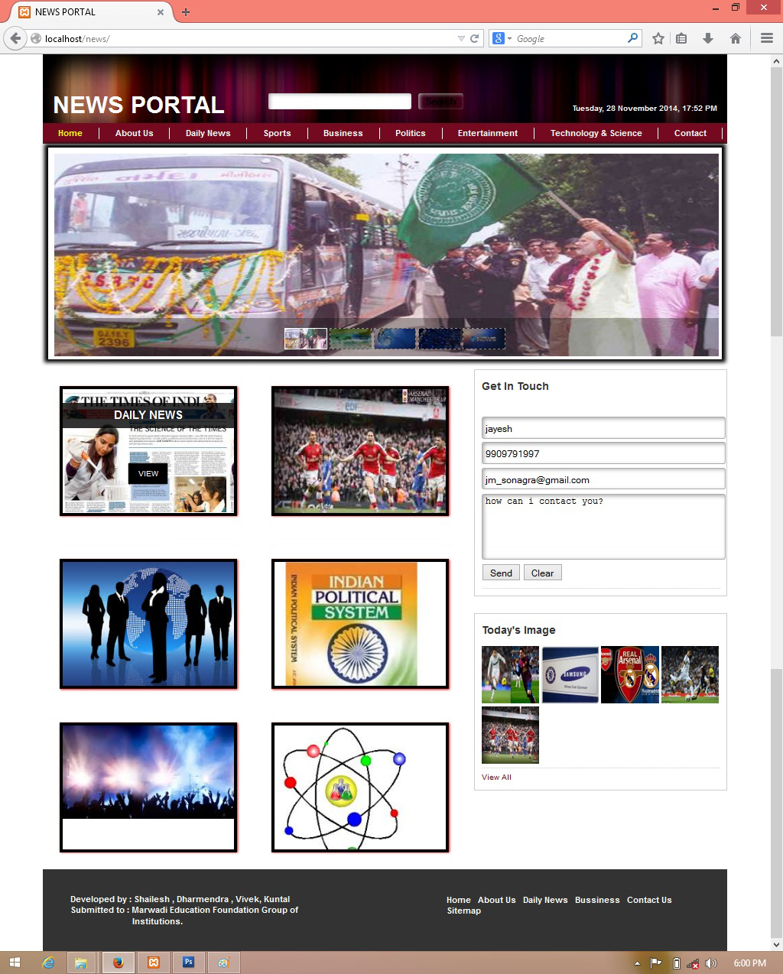
index

Slide 16
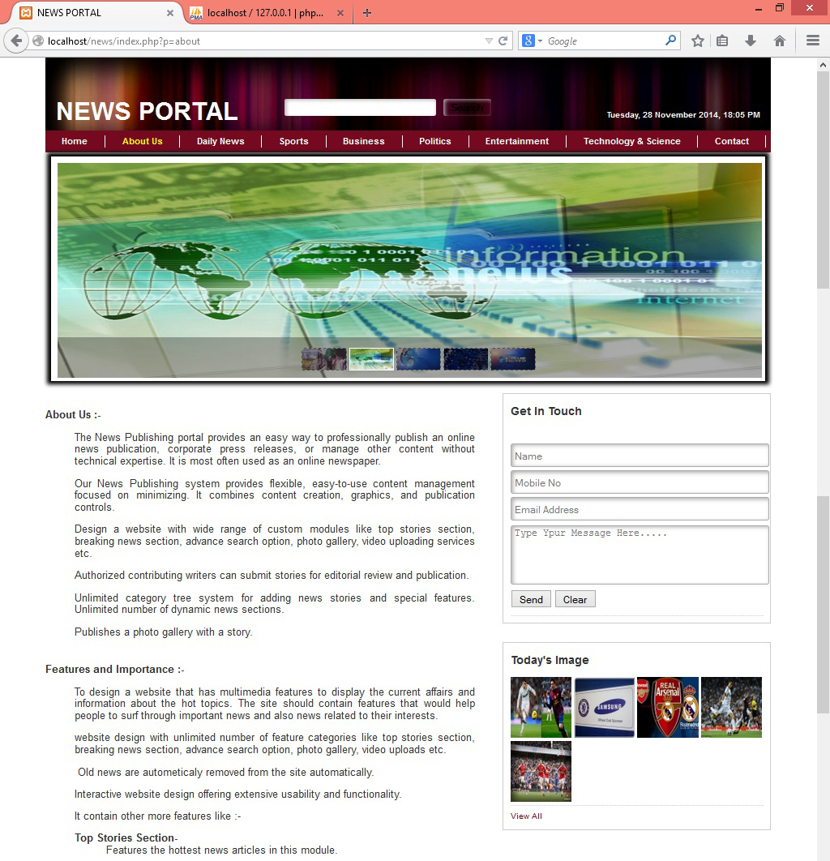
About us

Slide 17
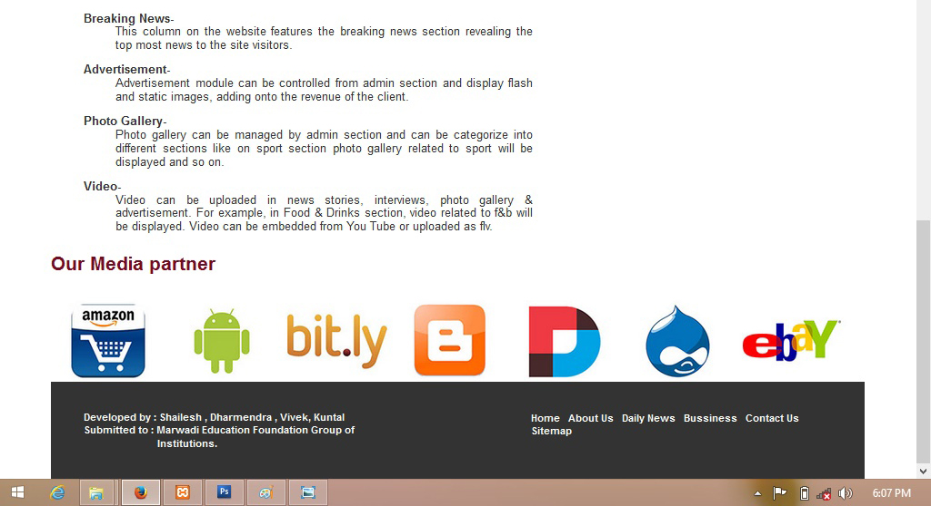
About us

Slide 18
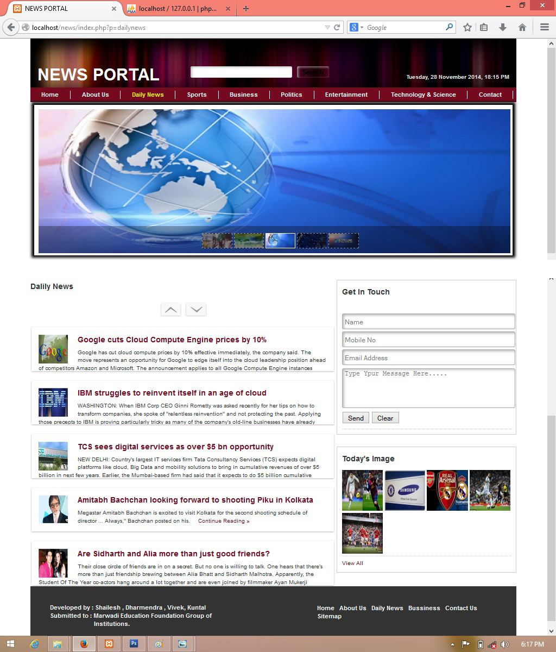
Daily News

Slide 19
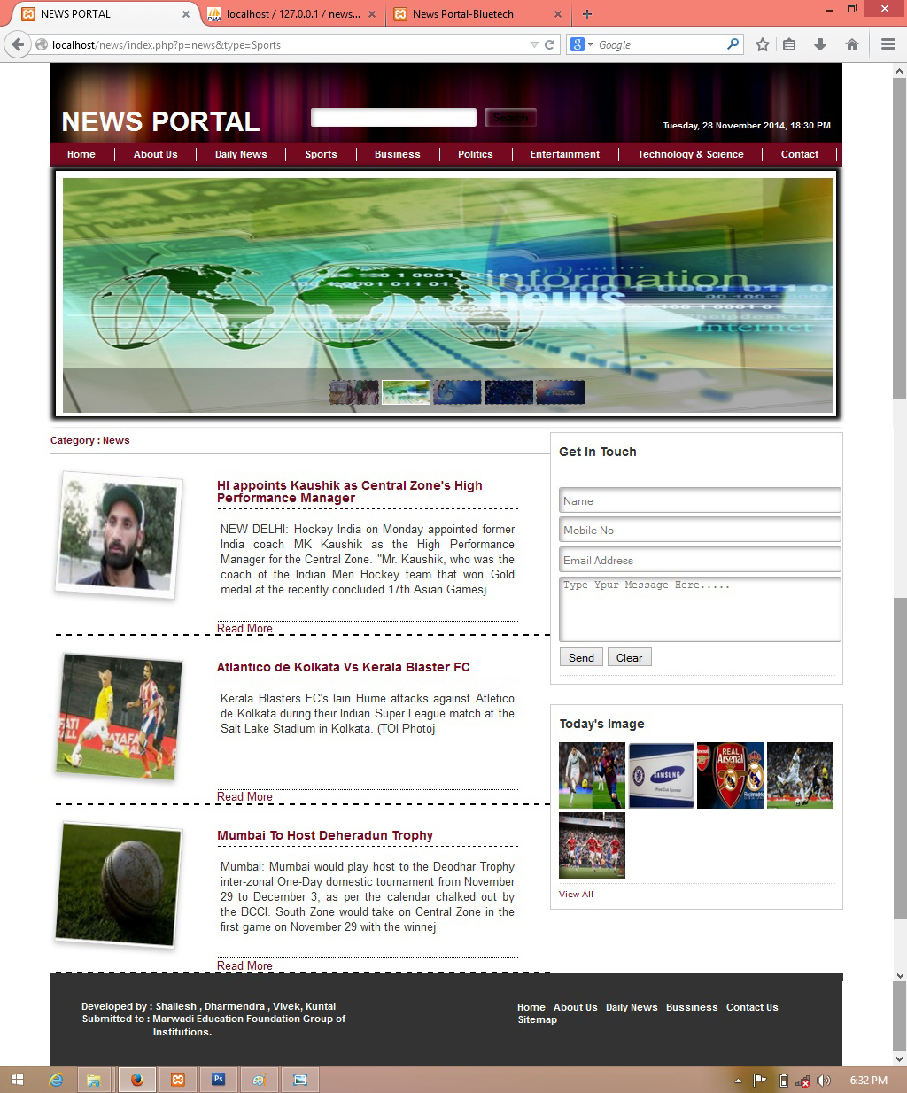
Sport

Slide 20
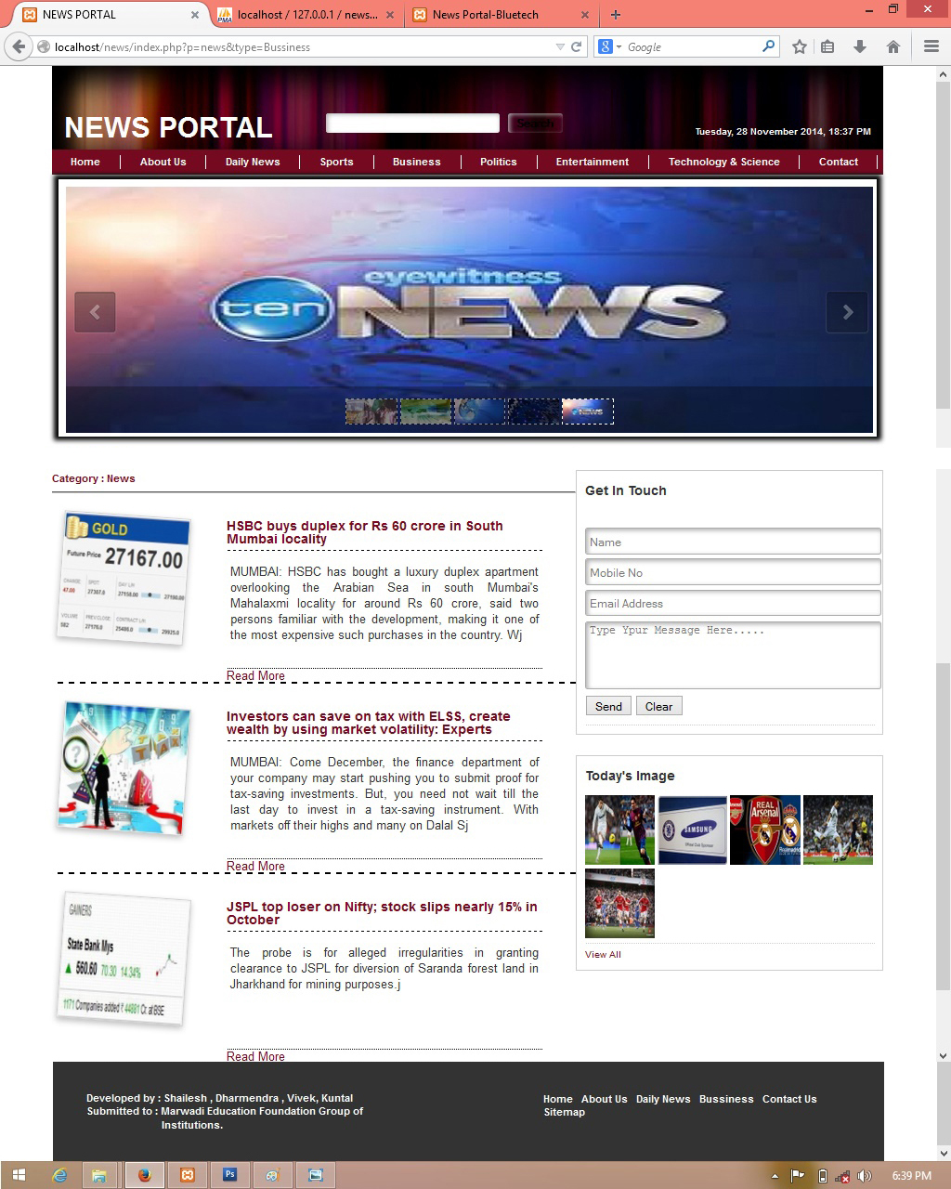
Business

Slide 21
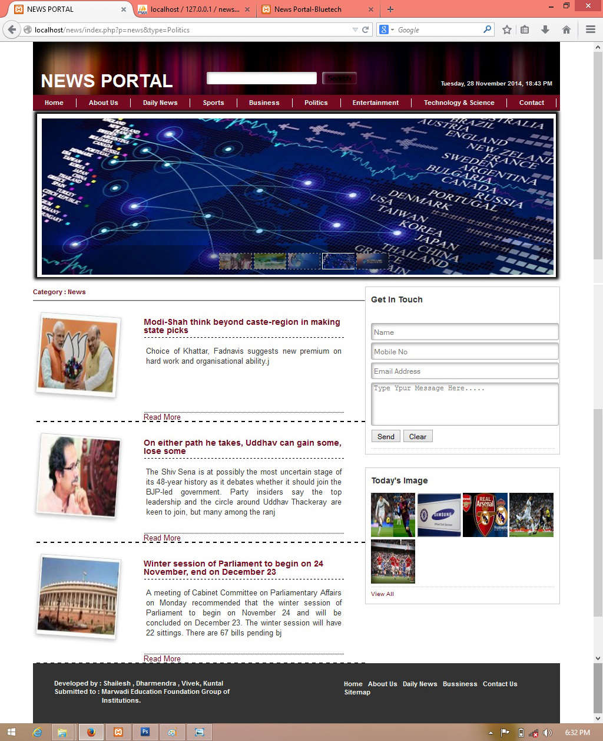
Political

Slide 22
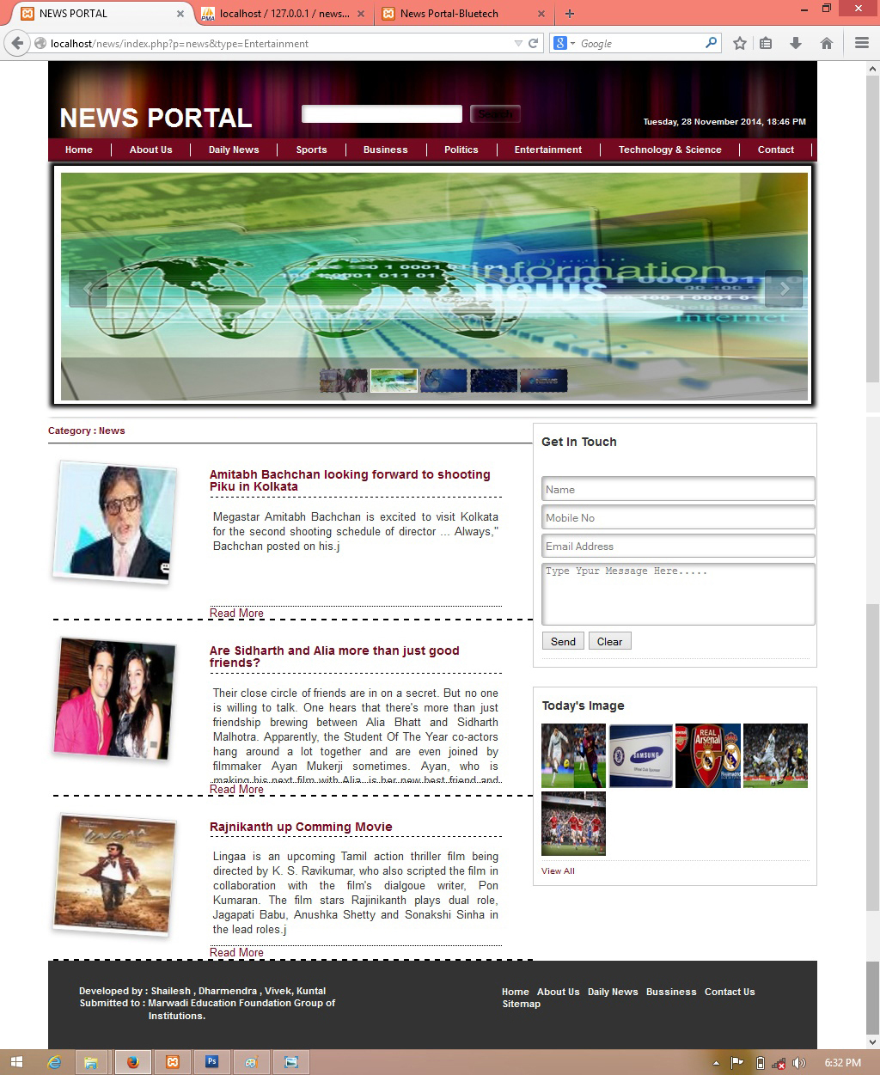
Entertainment

Slide 23
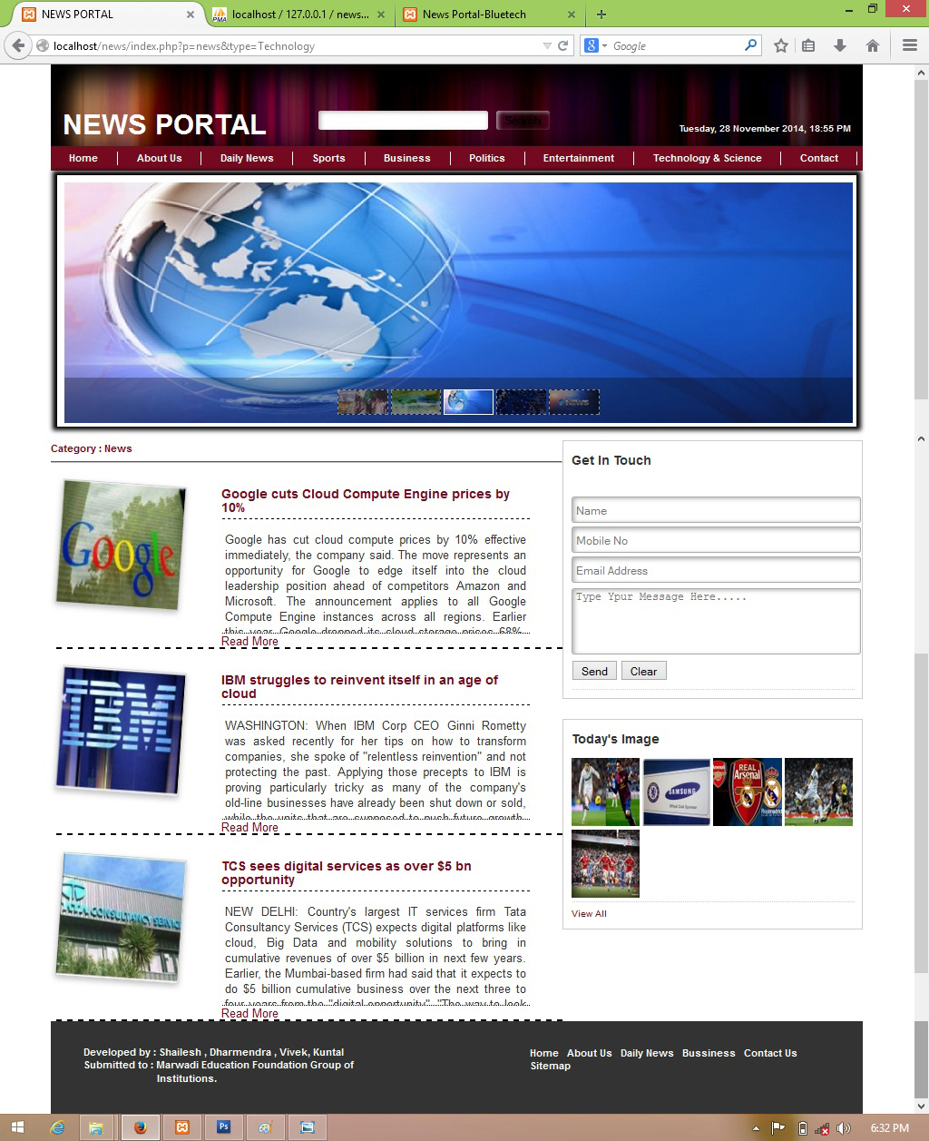
Science & Technology

Slide 24
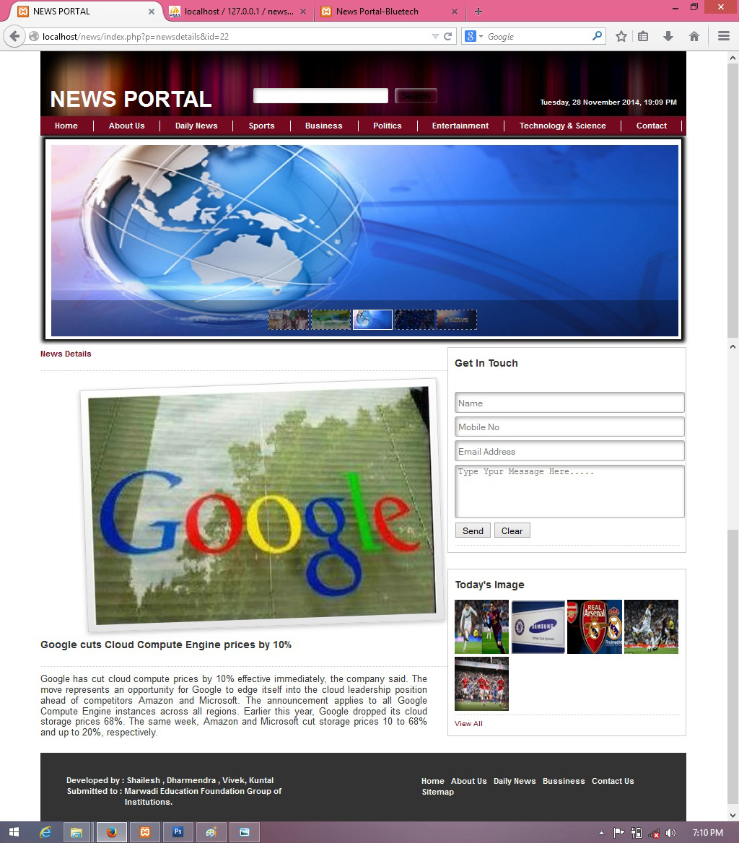
Read More News

Slide 25
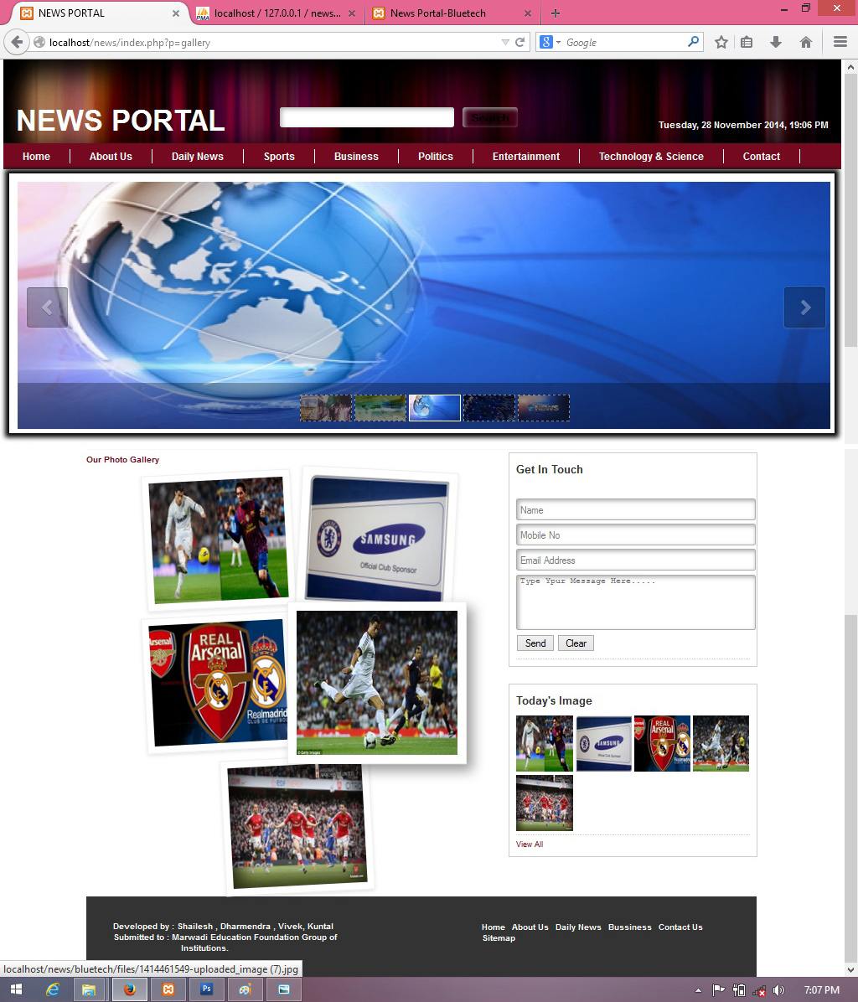
Photo Gallery

Slide 26
snapshots
admin SIDE

Slide 27
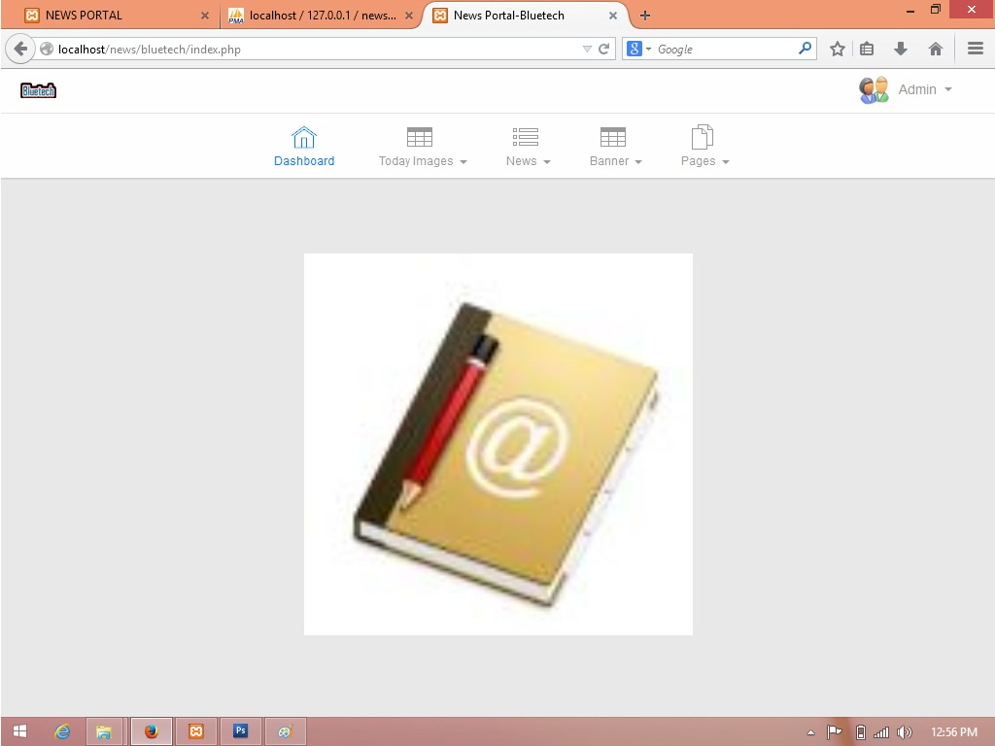
index

Slide 28
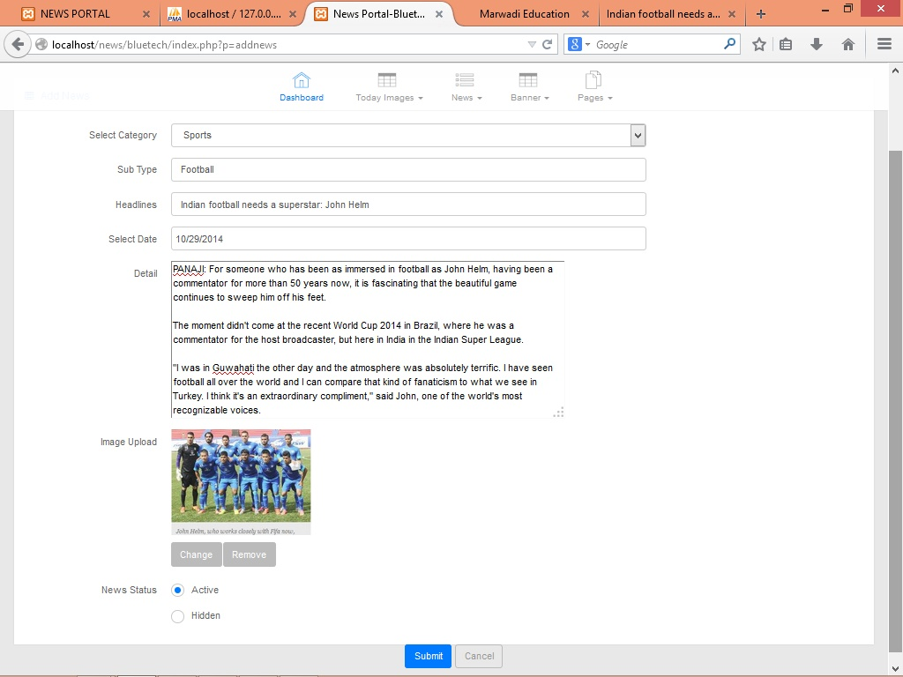
Add News

Slide 29
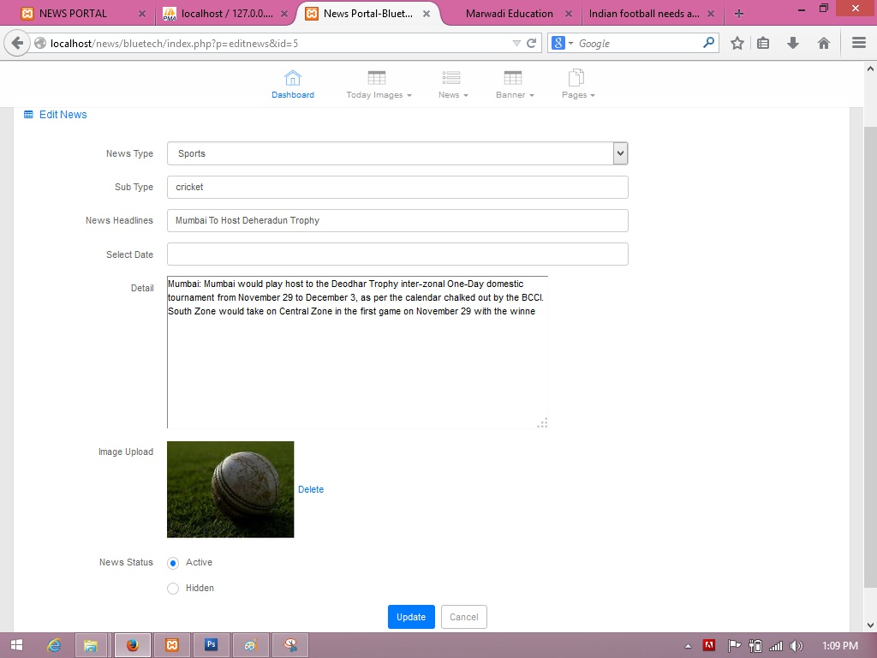
Update News

Slide 30
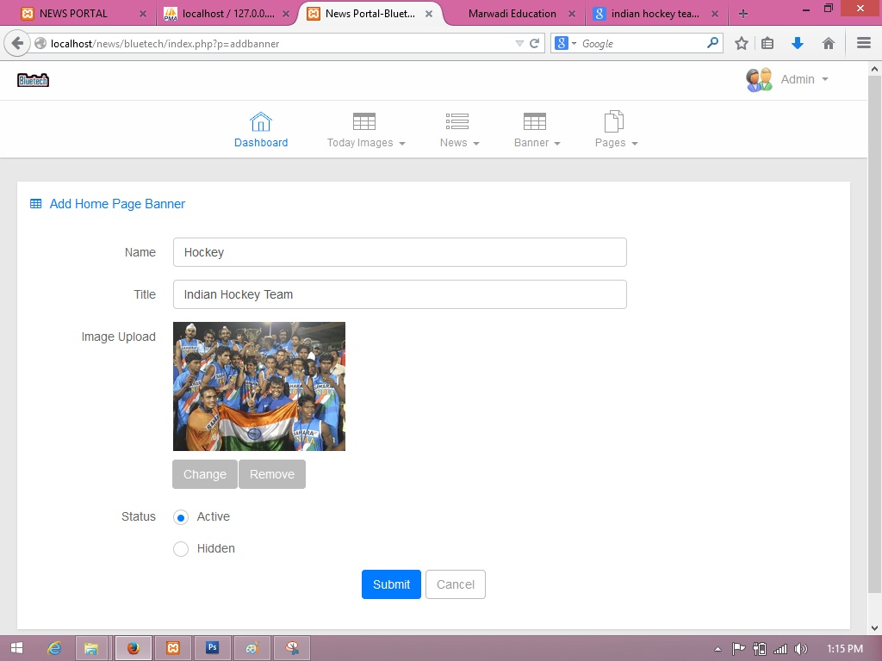
Add Banner

Slide 31
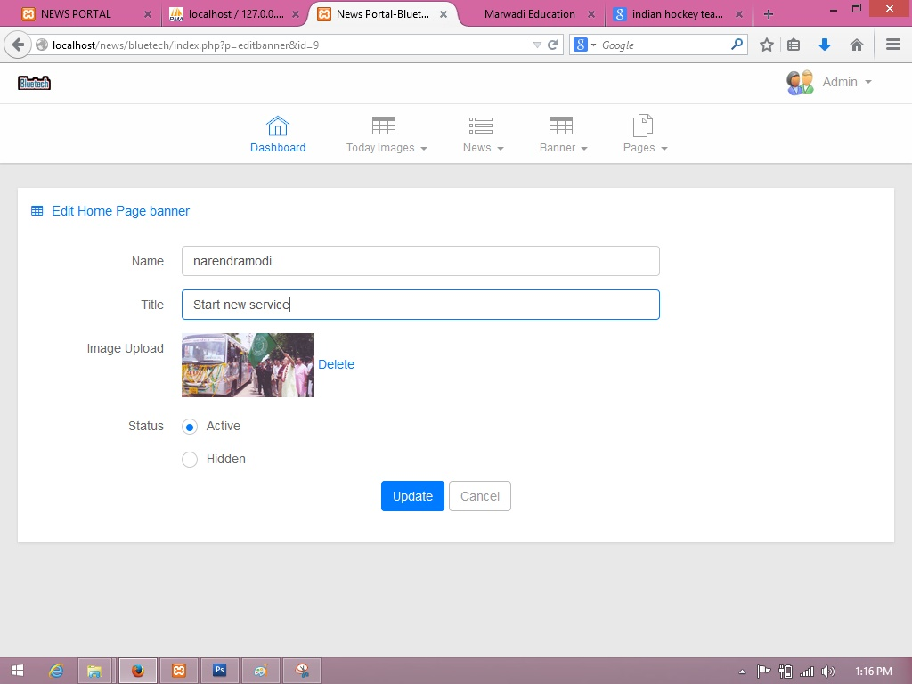
Update Banner

Slide 32
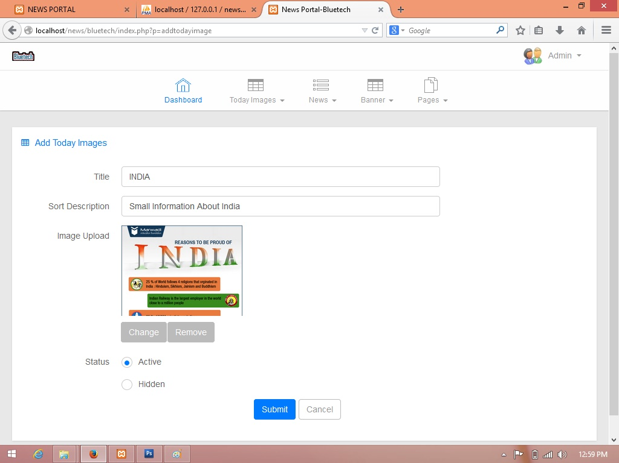
Add image

Slide 33
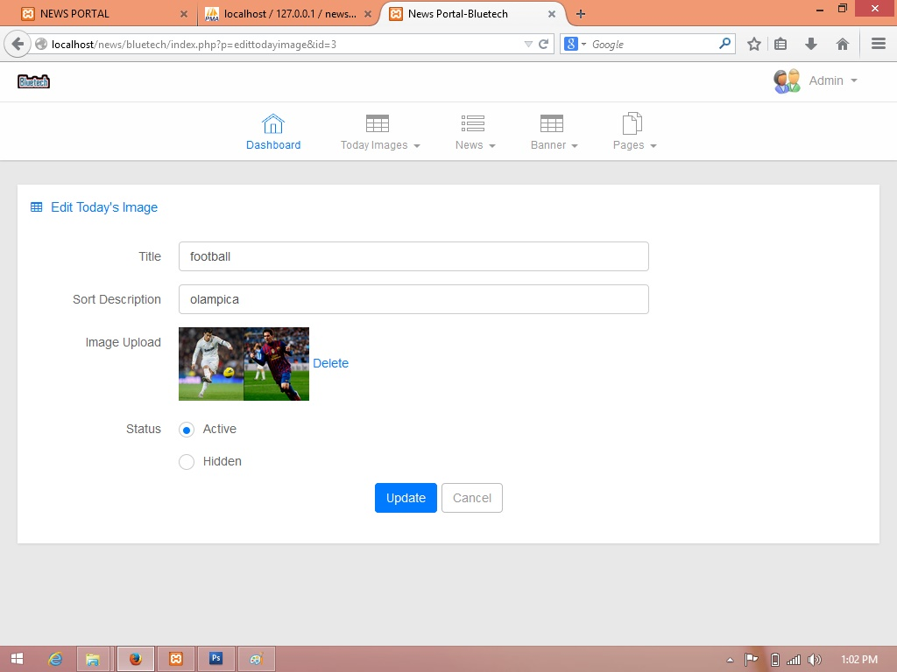
Update Image

Slide 34
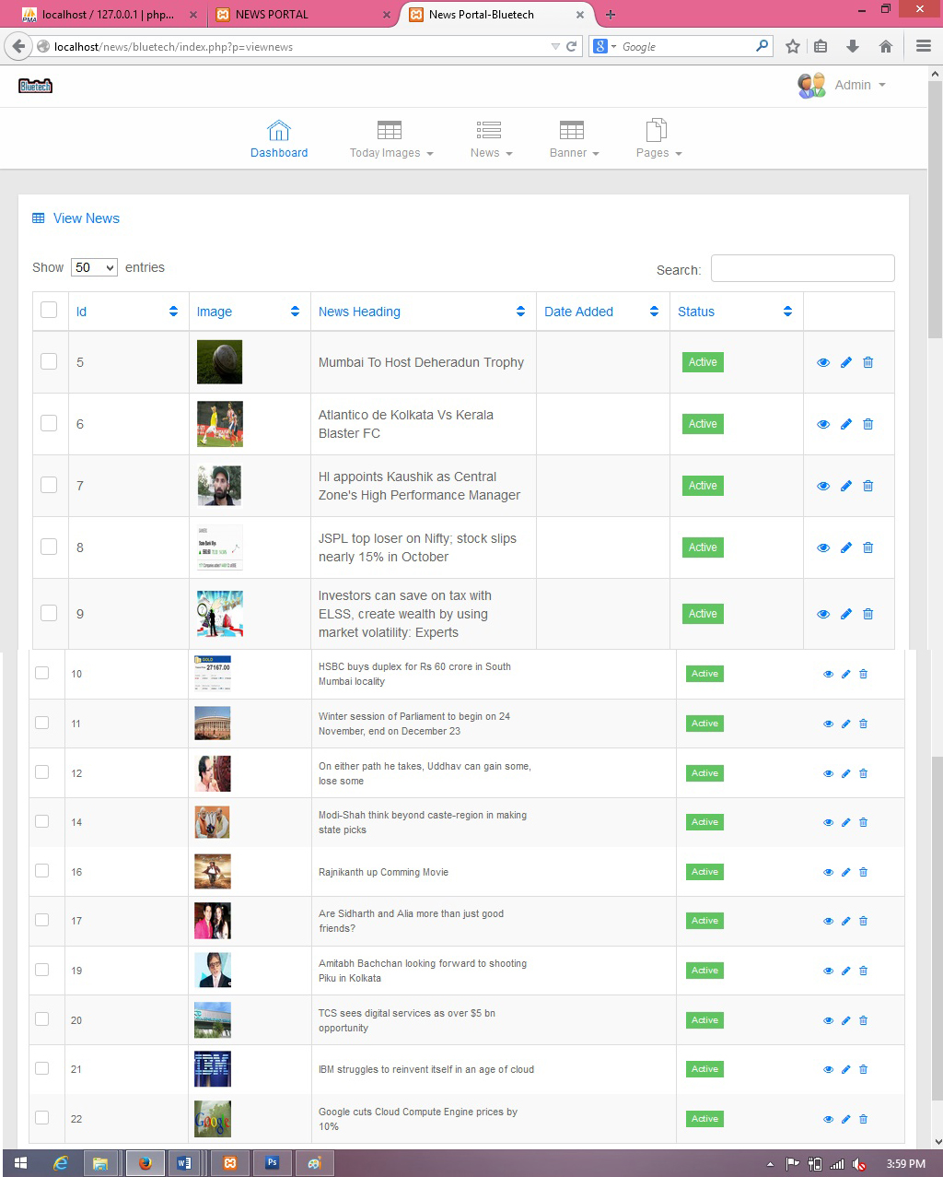
View All News

Slide 35

FUTURE ENHANCEMENT
As a future enhancement, an add-on feature can be added to the project of “News broadcasting”, where an interested user can broadcast an event on the website.
For which one needs to get registered first by making a request to the administrator of the website.

Slide 36

BIBLiOGRAPHY
Reference Books:
Beginning PHP5,APACHE,MySQL Web Development
Authors: Elizabeth Naramore, Jason Gerner,
Yann Le Scouarnec, Jeremy Stolz,
Michael K. Glass
Publisher: Wiley Publishing Inc.
Websites:
www.w3schools.com
www.stackoverflow.com
www.php.net

Slide 37


